Slide 1

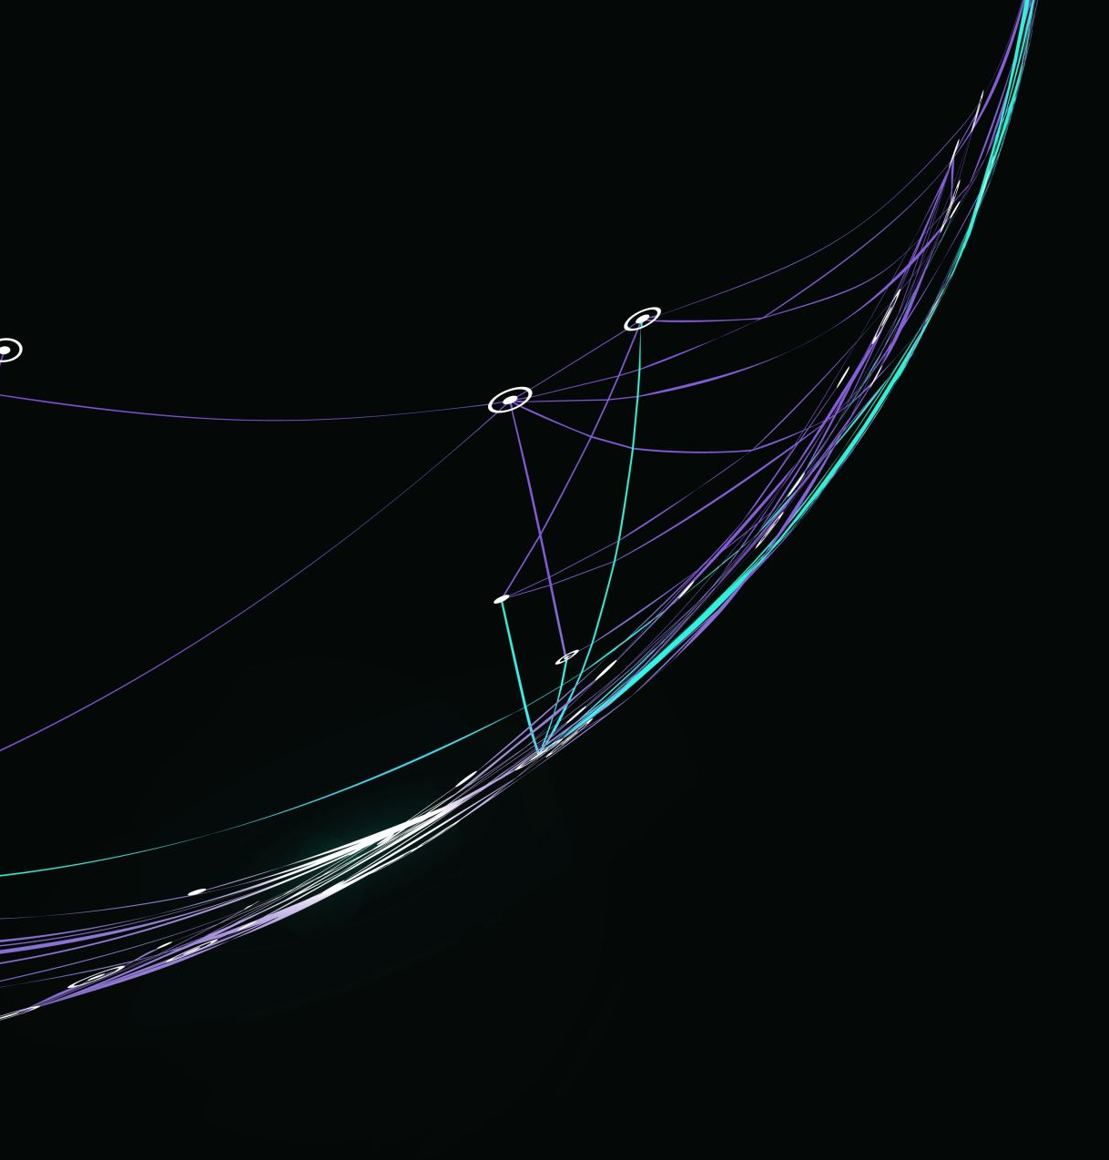
Reddit Recommendation System
Jan Gruszczyński
Mikołaj Kruś
Maciej Filanowicz
Kacper Trębacz
Notes:
Tu sie witam

Slide 2

Introduction to Reddit
Notes:
Tu wprowadzam po krotce jak wyglada reddit

Slide 3
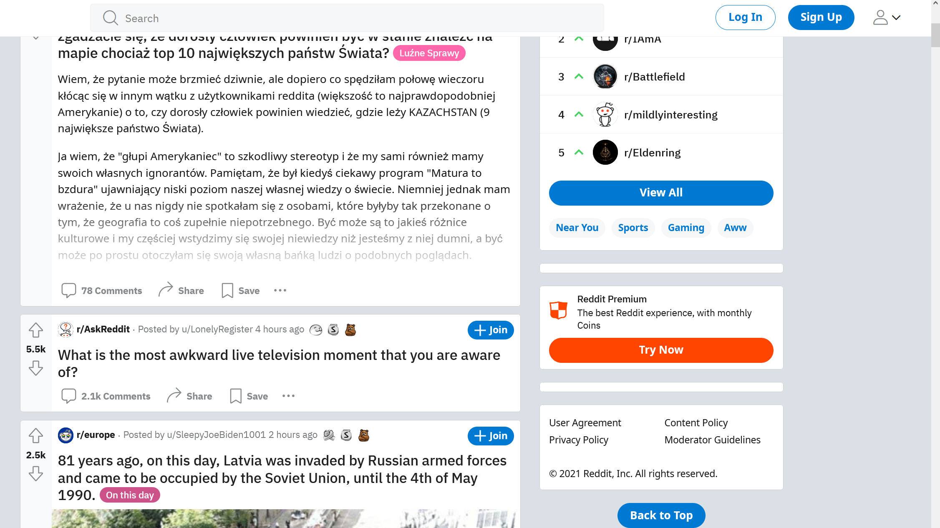

Slide 4
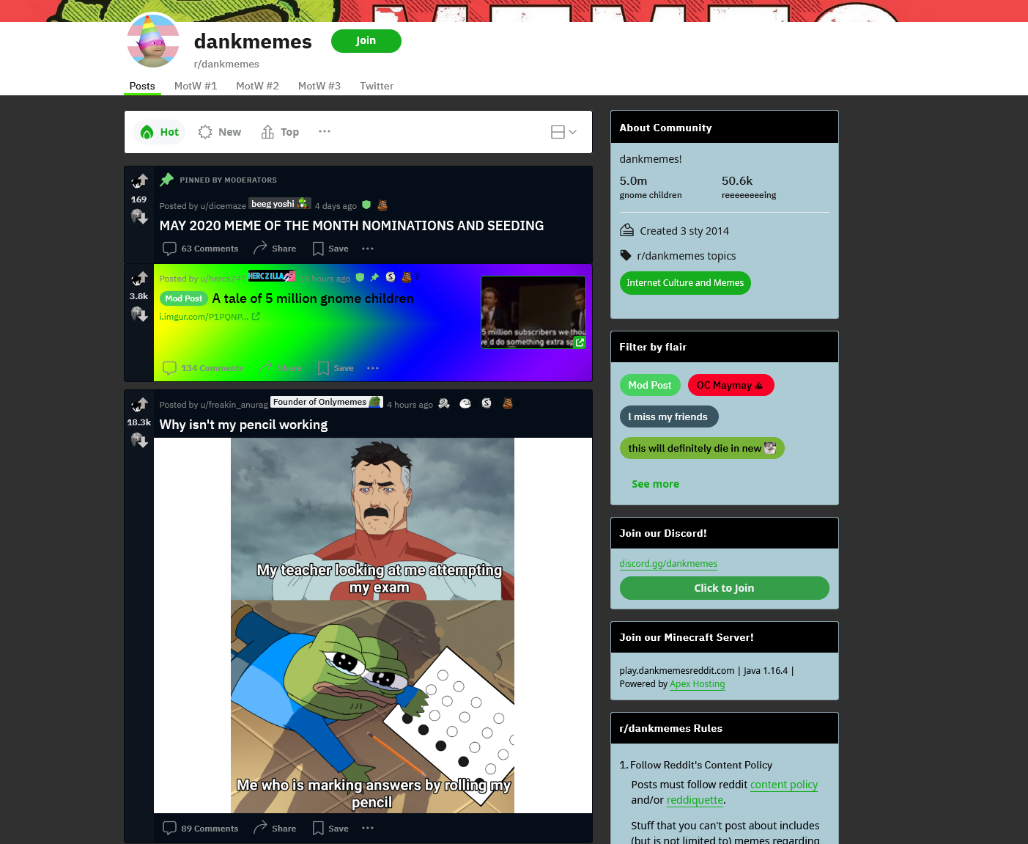

Slide 5
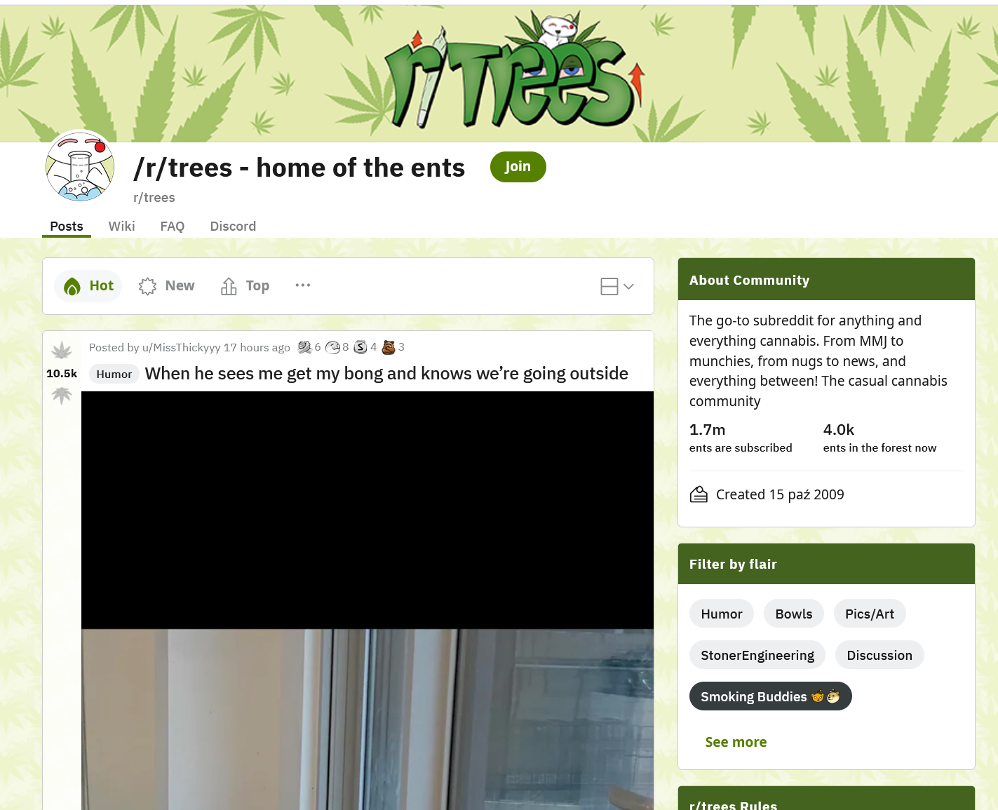

Slide 6
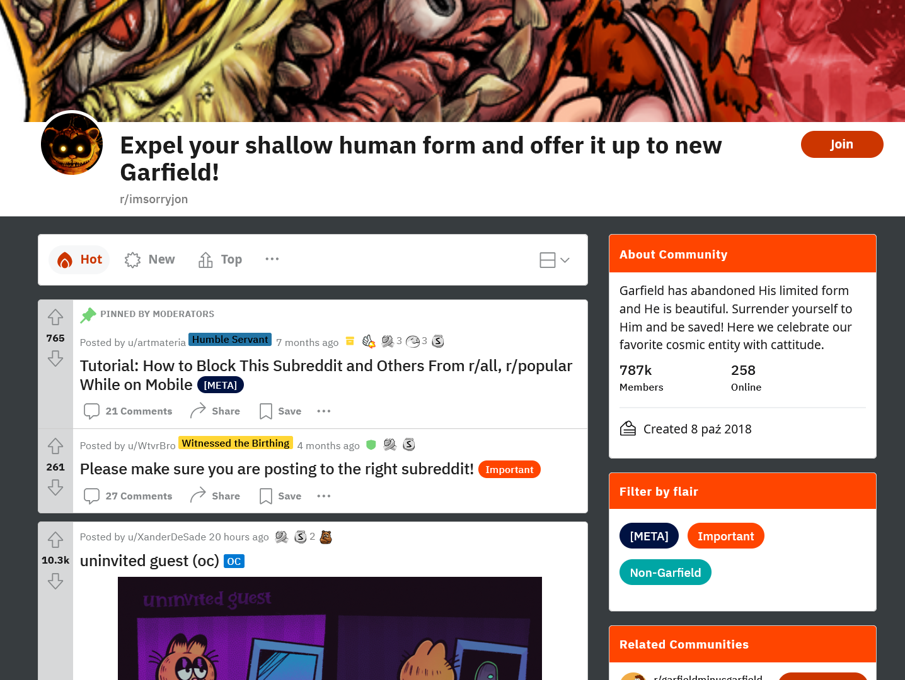

Slide 7
Business Objective of the project
Increase the time spent by users on the website
Increased ad revenue – main source of income

Slide 8
Goal of the project – how to satisfy business objective
Creation of intelligent recommendation system of subreddits based on user comment history.
Increase of users satisfaction
Easing the process of assimilation for new users

Slide 9

Data selection
First choice: Pushshift datasets
Second choice: Our own scrapper using library PRAW for python

Slide 10
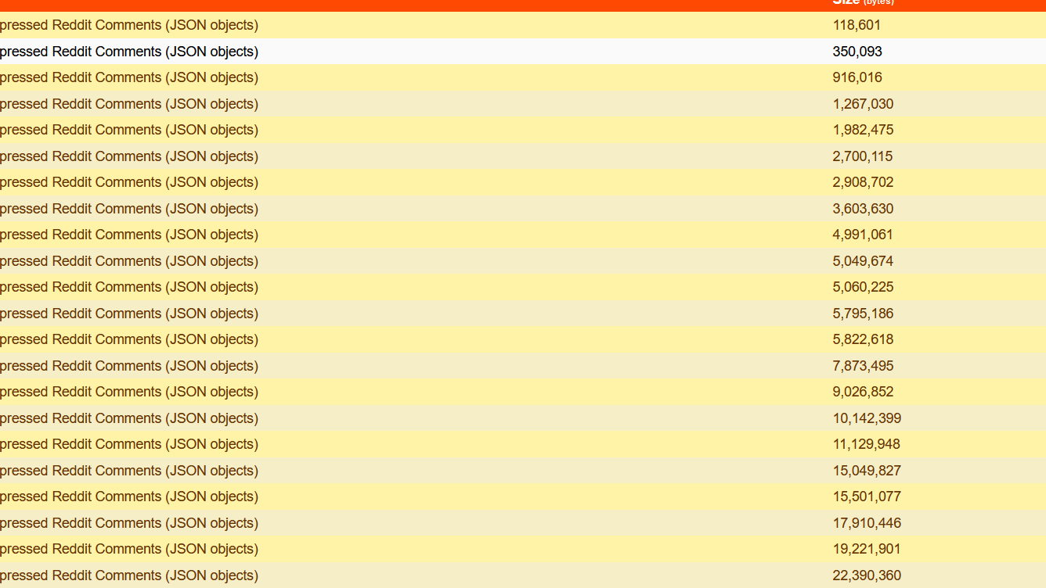

Slide 11
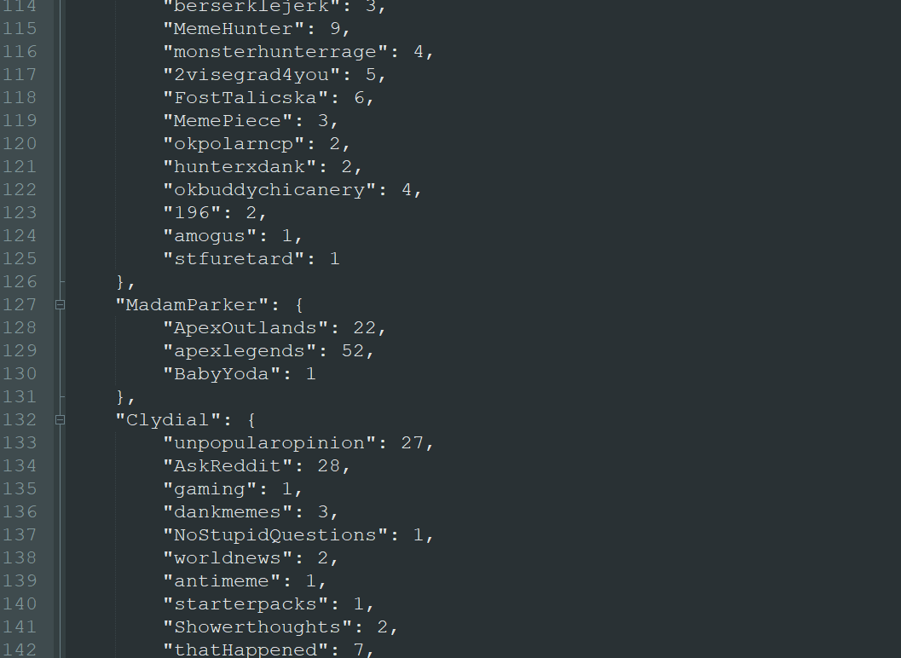

Slide 12
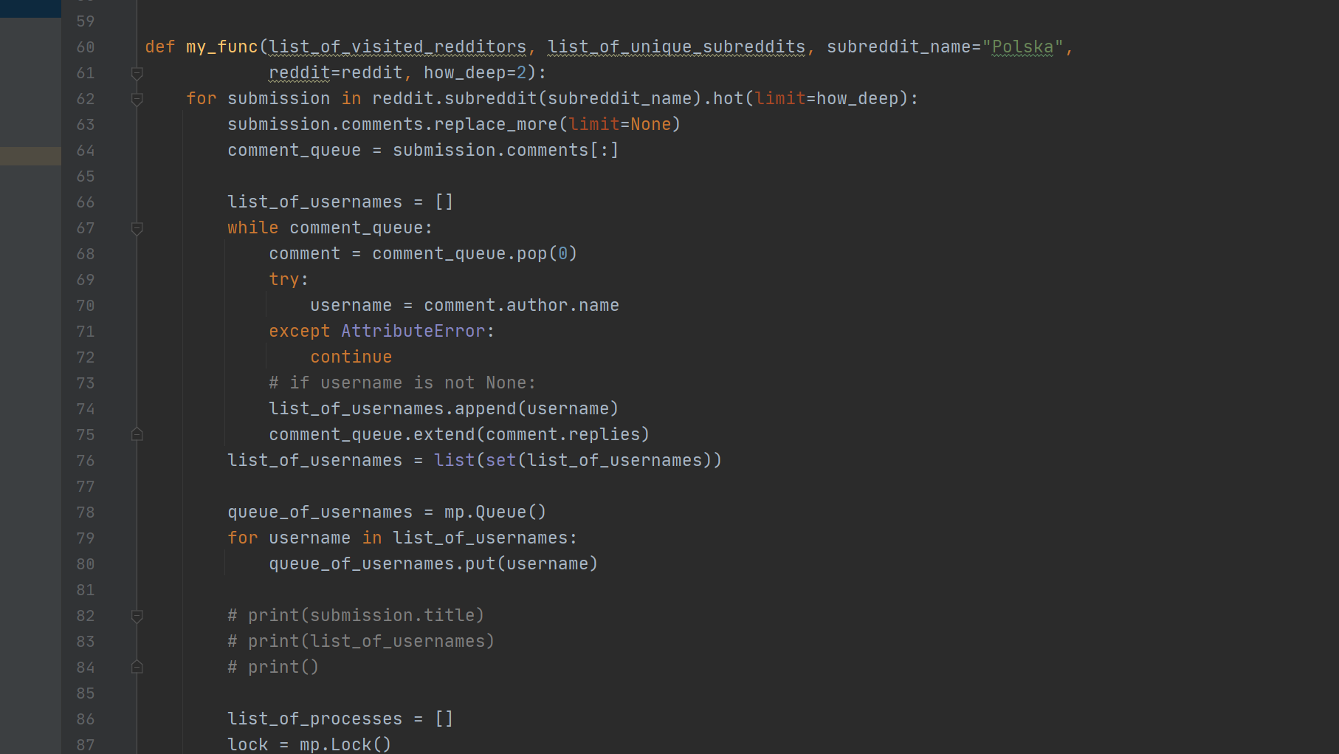

Slide 13
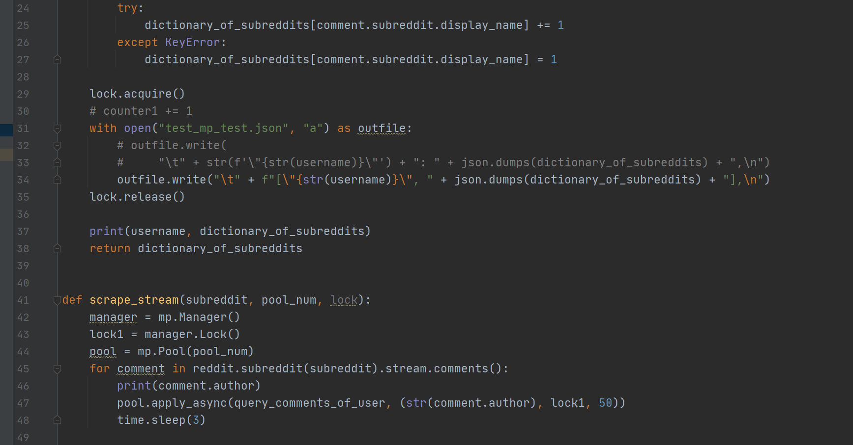

Slide 14
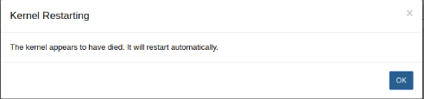
Association Rules
Reddit dataset
Popular subreddits – out of memory :(
LIft me up
More data and 5000/ 10000 top subreddits
Kliknij, aby dodać tekst

Slide 15

Rules Database
Using SQLLite
Lower RAM usage
Query time 2s vs ~80ms using pandas

Slide 16
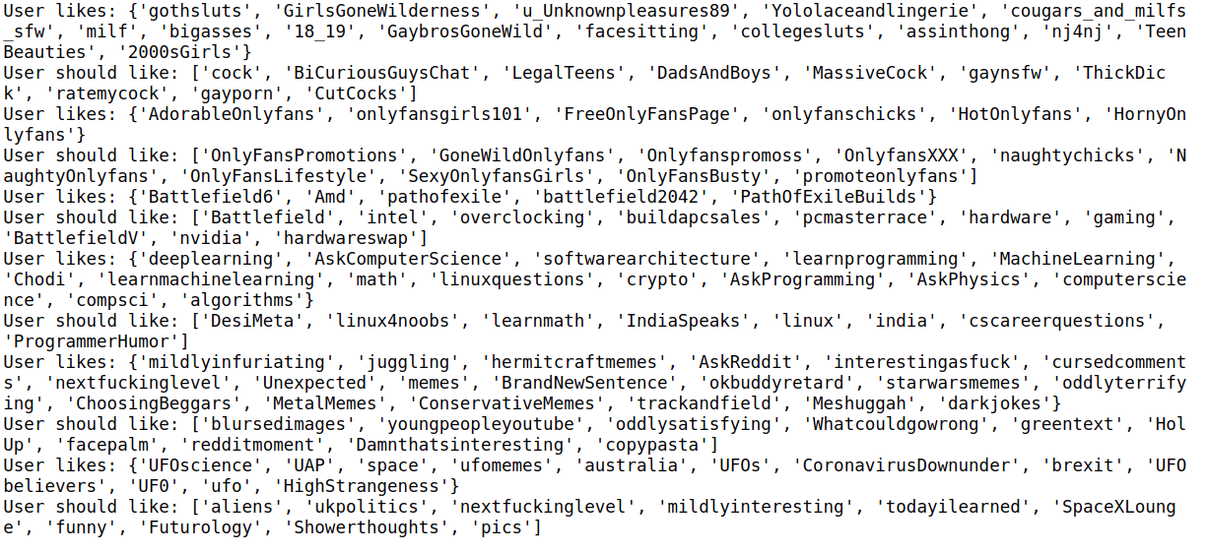
Results top 5000

Slide 17
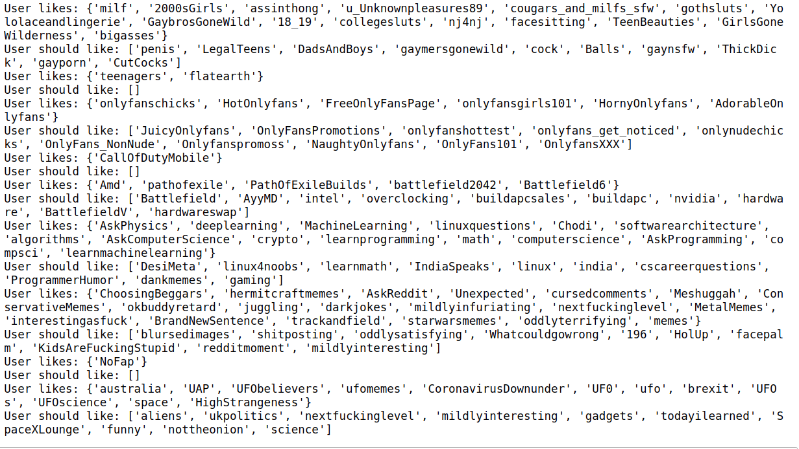
Results top 10000

Slide 18

Dimension Reduction
PCA
tSNE

Slide 19

Clustering

Slide 20
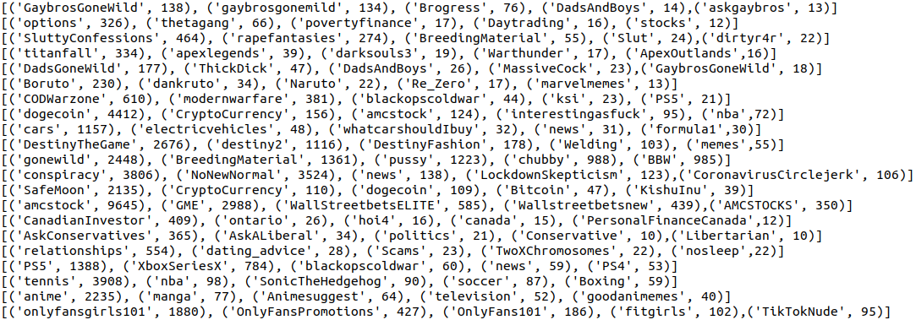
(some) Clustering Results

Slide 21
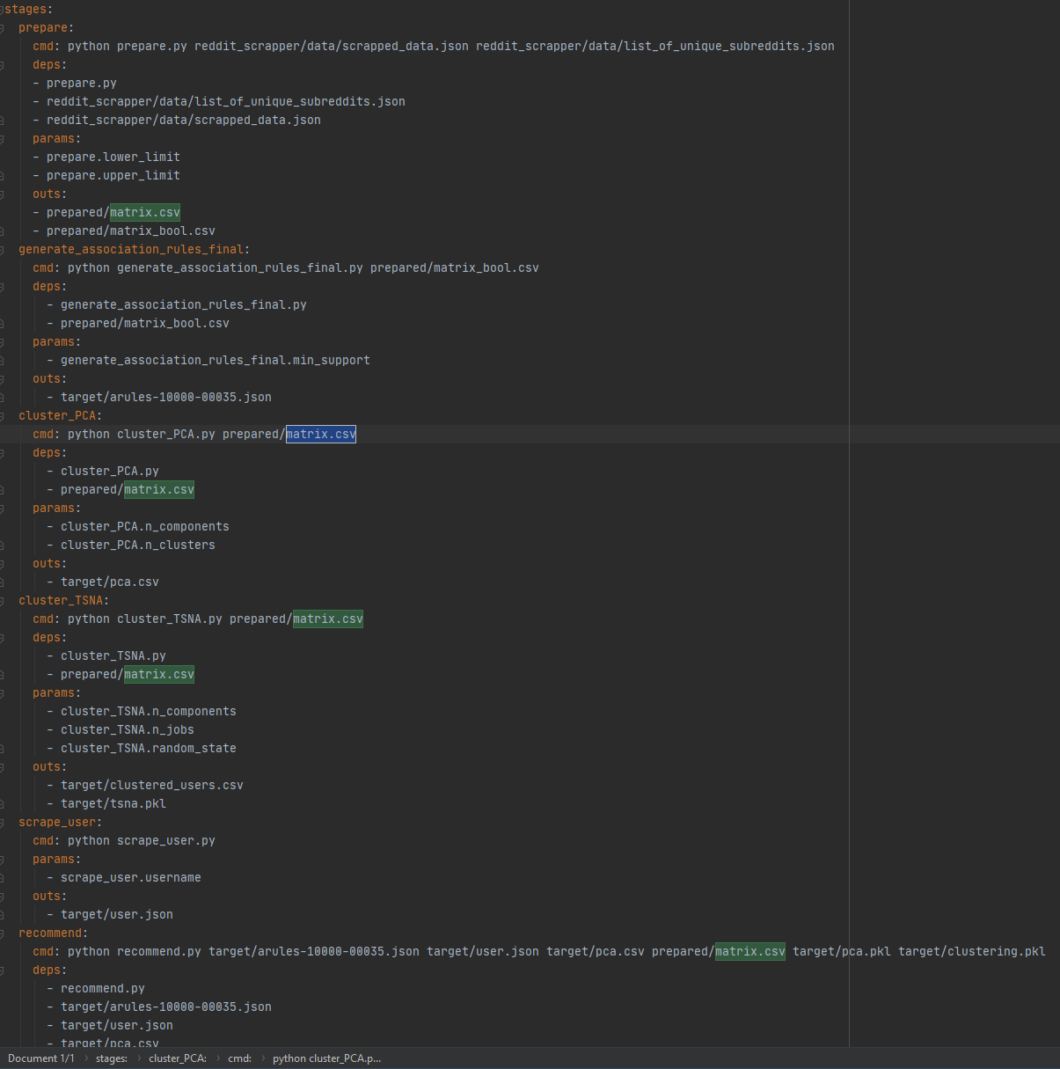
dvc.yaml

Slide 22
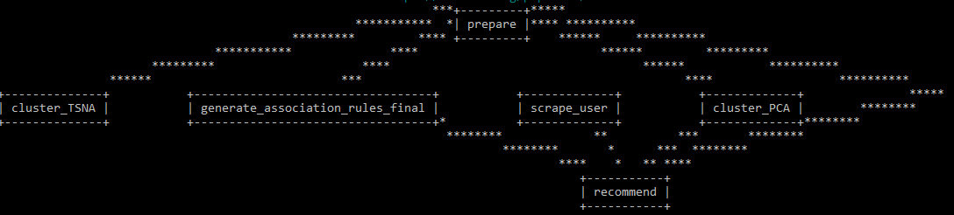
DVC pipeline

Slide 23


THE END

